Slide 1
Finalizing Results, Review and Sensitivity Testing
Gretchen Donehower
Day 2, Session 2, NTA Time Use and Gender Workshop
Tuesday, May 22, 2012
Institute for Labor, Science and Social Affairs (ILSSA)
Hanoi, Vietnam

Slide 2
Outline
Finalizing Results
Smoothing
Review results for interesting patterns
Sensitivity Testing

Slide 3
Finalizing Results
In NTA, finalizing results usually means adjusting to macro controls, but NTTA doesn’t have macro controls
Instead, finalizing in NTTA at this stage means smoothing
Need to examine smoothers individually, by looking at them
Make sure you adjust the spans so as not to “smooth over” a real pattern (many of the care variables will need smaller spans than other household activities)
After we calculate consumption, there will be an adjustment to make sure that consumption and production balance, but we are not at that stage yet

Slide 4
Four Different Smoothers
Stata’s Lowess
Pros: easy to use, built in, familiar method
Cons: does not accept weights (sample weights or population weights if your data does not include sample weights)
Stata’s Lowess with “expand” to weight the data
Pros: uses lowess which is easy
Cons: expand can make a huge dataset and take a long time to run
Stata’s .ado file for “autosmoo,” which accepts weights
Pros: stays within Stata so you don’t have to mess with R
Cons: have to find and install, unfamiliar methodology and not so satisfying results with small spans
R’s “supsmu” (Friedman’s super smoother)
Pros: good smoother and small span results come out very well
Cons: have to implement in R which can be confusing and clunky if you have not used R before

Slide 5
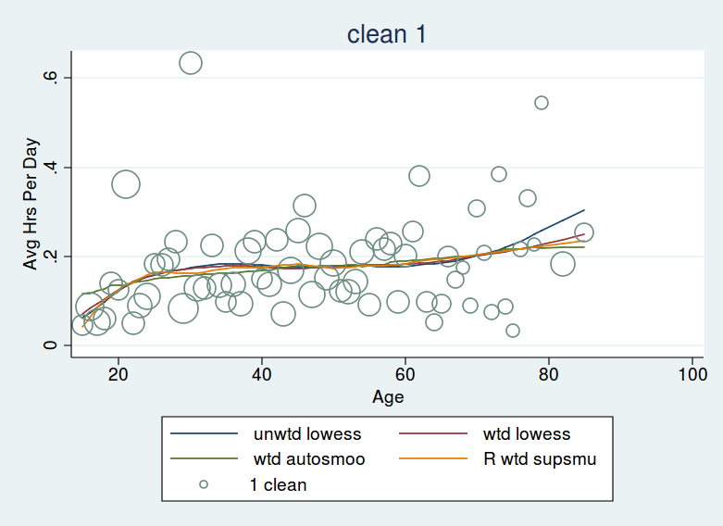
Comparing Smoothers
See code and plots

Slide 6
Review Results for Interesting Patterns
Examine results in time units and money units
Time units are very interesting to people
Difference in male/female patterns in time versus money units will also give interesting results
Can examine interesting patterns to investigate their causes
Are patterns consistent across regions? Across socioeconomic status?
Are they related to government programs, or cultural norms?
If you have more than one time use survey, are patterns stable over repeated cross-sections?

Slide 7
Sensitivity Tests
Change methodology to evaluate how different results would be if you made different assumptions
Where is the methodology driving the results?
Wage Imputation
Opportunity cost versus replacement (BIGGEST EFFECT BUT ALSO NOT A REASONABLE ALTERNATIVE FOR ALL ACTIVITES; MAYBE IMPLEMENT JUST FOR CARE ACTIVITIES)
Different wages used for replacement method
Inclusion of activities
Including secondary activities or not (ALSO BIG EFFECT)
Including activities which may not pass the third party criterion

Slide 8
Lab Session
Work through US example code
Smooth your results, noting any interesting patterns
Be ready to share some plots at the end of the session

